Slide 1
Operating Systems Project
Odometer Android App
By-
Yash Sharma
Shubham Swarnkar
Vishal Chauhan

Slide 2
Contents
•What is an Odometer?
•What’s our App about?
•Motivation.
•Description.
•Problems.
•Solutions.

Slide 3
What is an Odometer?
Odometer is an instrument that calculates the distance traveled by a vehicle or a person when they move from one place to another.

Slide 4
What’s our App about?
Our Android App provides
•Distance Travelled by a person during jogging.
•Calories Burnt during the same.

Slide 5
Motivation
In today’s fast paced world, jogging is the most popular exercise for fitness conscious people.
Wouldn’t it be great to know the total calories we just burnt right after we finish our jogging!
Not only will it help us to manage our diet but will also keep us motivated.
So we developed an App that fulfils exactly the same purpose.

Slide 6
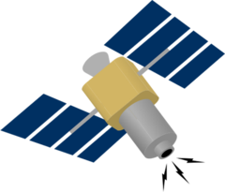
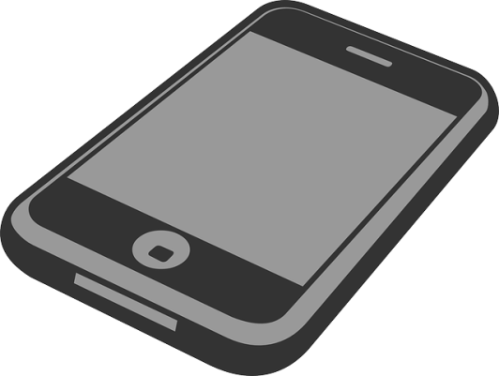
GPS

Slide 7
Inside The App!

Slide 8
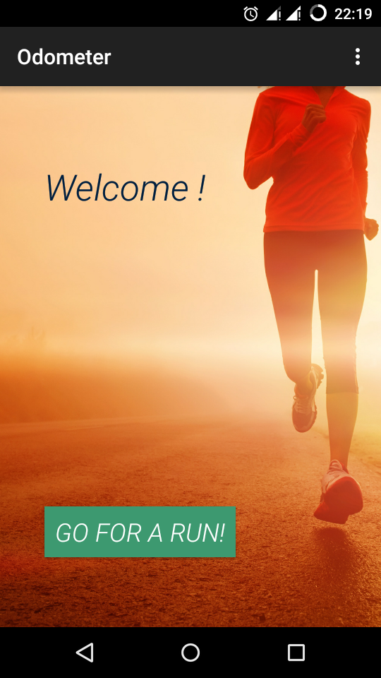
This is the home screen.
As you start jogging, press the “Go For A Run” button. It will prompt you to enter your details first and also to enable the GPS if it isn’t yet enabled.

Slide 9
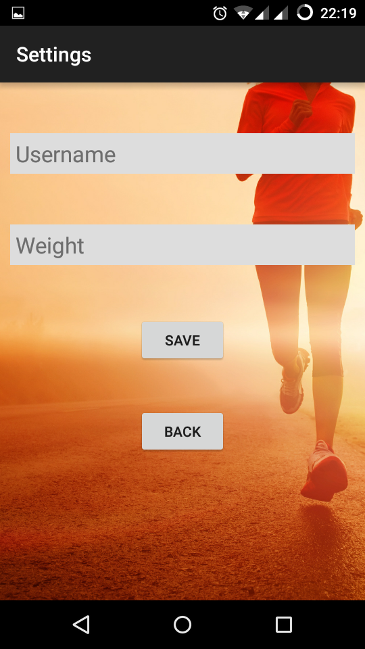
User will then be directed to the Settings screen, where he has to enter his name and weight (in kilograms).

Slide 10
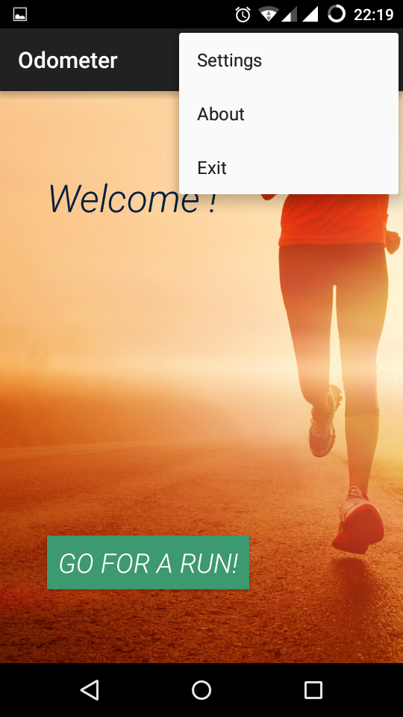
A Context Menu is provided at the home screen which can navigate the user to Settings or the About section or to Exit the app.

Slide 11
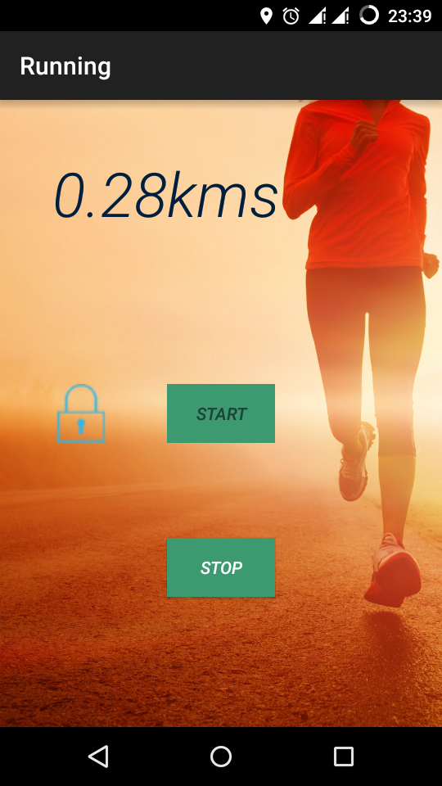
With all the information filled in and GPS enabled, user can start using the app.
The app displays the total distance travelled in real time.

Slide 12
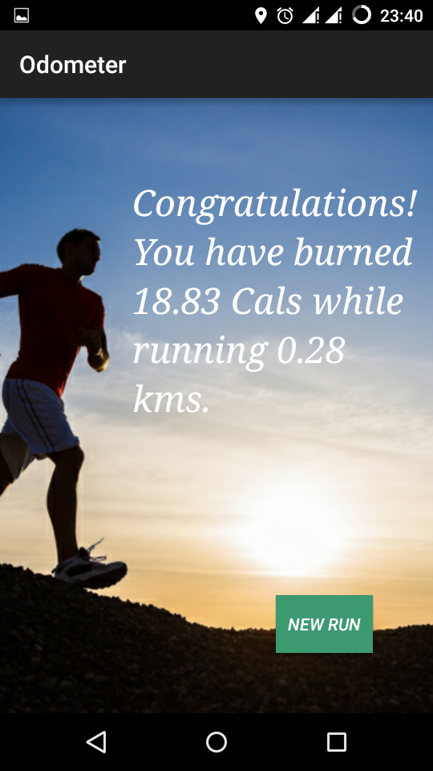
In the end, the app will display the distance travelled along with the calories you just burned.

Slide 13
Internal Working
•The backbone of the app is a service (thread), which runs in the background while the user is running.
•It fetches the device’s current location from Android’s Location Service, calculates the distance from the last location and adds it to the total distance covered.
•The distance is refreshed and the content on the screen is updated after each second.

Slide 14
Problems that we faced
GPS Access
Storing Data
Validating Input
The biggest problem that we faced was gaining the access of the device’s GPS for the application.
Another major problem was to use database connectivity for storing details of the user.
To validate the data entered by the user in the Username and Weight input was also a challenging task.

Slide 15
Solving the problems...
GPS Access
Storing Data
Validating Input
For enabling our app to use the device’s Location Service, we declared
ACCESS_FINE_LOCATION in the Android Manifest File.
For storing user details we used shared preferences instead of a database.
For validating user’s input, we used Regular Expressions.

Slide 16
Thank You!

